Slide 1
X rays
Production of X Rays, Quality and Intensity of X Rays, Characteristics X-ray generation , Bremsstrahlung/ Braking X-ray generation

Slide 2

X Rays
Are electromagnetic radiations having wavelength of order of 1$A^{0}$
Are highly energetic radiations which are emitted when energetic electrons are made to incident on a metallic target.
Were discovered by German Physicist W.C. Roentgen in1895.

Slide 3
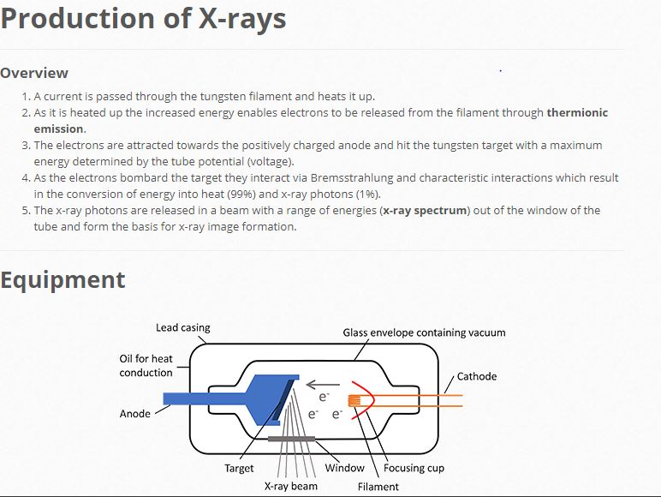

Slide 4
Quality of X -Rays
Quality of X -Rays is their penetrating power. Quality of X Rays depends on the energy of the incident electrons which further depends upon the voltage applied between cathode and anode. Kinetic energy of electron = eV. It means the quality of X Rays can be controlled by changing the applied voltage in the tube. On the basis of quality or penetrating power the X rays are of two types:
Hard X- rays: X- Rays consisting of highly energetic photons which has more penetrating power. Hard X- rays can be produced either by using target of higher atomic number or applying high voltage between cathode and anode.
Soft X- Rays: X- Rays consisting of low energy photons having low penetrating power. Hard X- rays can be produced either by using target of low atomic number or applying low voltage between cathode and anode.

Slide 5
Intensity of X-Rays:
The number of photons in an X -Ray beam represents its intensity (quantity). More the number of photons more is the intensity. The intensity of X- rays depends upon the number of electrons hitting the target which further depends upon the current in the filament. Thus intensity of X-rays can be controlled by controlling the current in the filament.

Slide 6
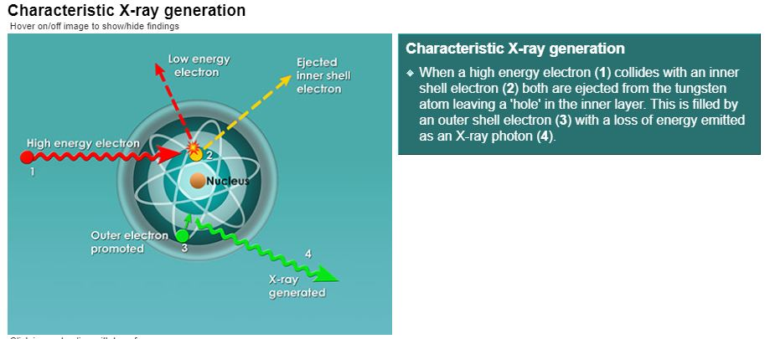

Slide 7
